Slide 1
Magnetopause reconnection rate and cold plasma density: a study using SuperDARN
Mark Lester¹, Adrian Grocott^{1,2}, Suzie Imber³, Steve Milan¹, Mick Denton⁴ and Joe Borovsky⁵
1. Physics and Astronomy, University of Leicester, Leicester, United Kingdom.
2. Also JSPS Invited Fellow, NIPR, Tokyo
3. Goddard Space Flight Centre, Greenbelt, MD, United States.
4. Lancaster University, Lancaster, United Kingdom.
5. Los Alamos National Laboratory, Los Alamos, NM, United States.

Slide 2
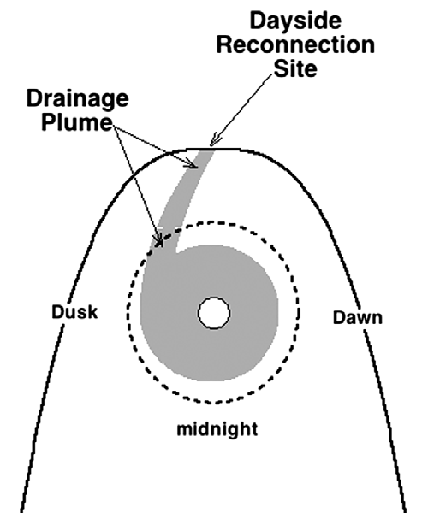
Introduction
Last year I talked about an analysis of SuperDARN data during so-called drainage plumes.
Borovsky and Denton (2006) demonstrated that based on AE the occurrence of cold plasma at geosynchronous was related with lower values of AE for given Kp levels
Proposed that the reason for this was the reduction in reconnection rate at the magnetopause
The cause of the reconnection rate reduction was the extension of the drainage plume to magnetopause reconnection site

Slide 3
                Impact of drainage
For periods of overall high magnetic activity (i.e. higher values of Kp) the AE value appears to be lower when high cold plasma density present at geosynchronous orbit (Figure 2)
Implication is that the cold plasma at the sub-solar magnetopause reduces the reconnection rate
Reconnection rate is related to the local plasma density
For two non-indentical plasmas (“1” and “2”), the rate is:
R= 0.1 B₁^{3/2}B₂^{3/2} / [μ_{o}^{1/2} (B₁+B₂)^{1/2} (B₂ρ₁+B₁ρ₂)^{1/2} [Cassak and Shay, 2007]
(Modelling with BATS-R-US shows same effect)
Borovsky and Denton, 2006

Slide 4
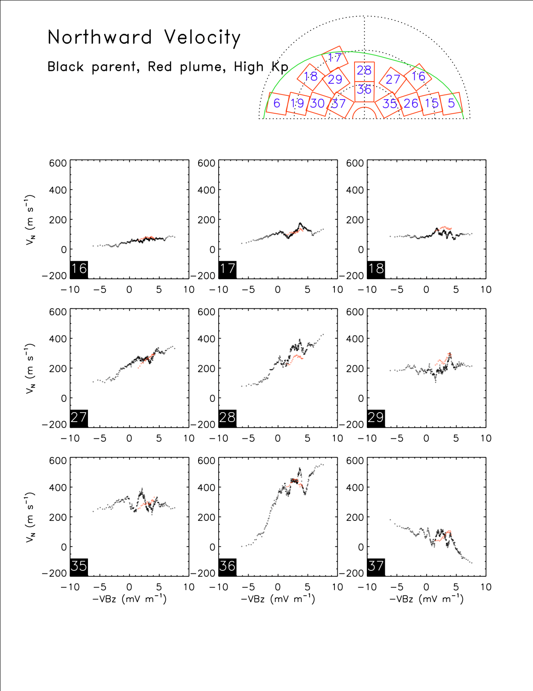
Northward velocity, High Kp
We worked with the statistcs data base of ionospheric convection created by Adrian Grocott
Study is based on the same data used by Borovsky and Denton to identify the cold plasma enhancements at geosynchronous
The bottom line at the time of last year’s meeting is that the evidence is somewhat mixed
For statistics Bin 28 there is evidence for a reduction in the northward flow near noon
But equally this is complemented by an increase in Bin 18

Slide 5
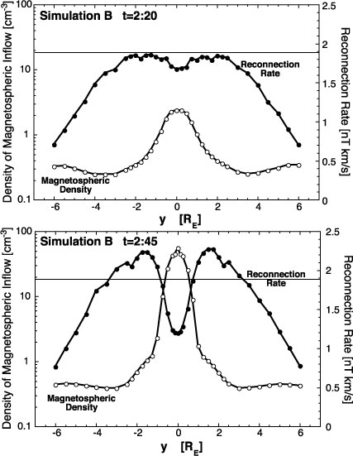
Simulation by Borovsky et al., 2008 indicates the existence of a reduced reconnection rate in localised region of the cold plasma density plume
Reconnection rate decreases as the cold density increases
Note also that as the reconnection rate decreases through the simulation near the density plume, it also increases larger and smaller GSM Y
Consequently expect that the flows driven under these circumstances would be locally reduced at footprint of plume but increased at earlier and later local times
from Borovsky et al., 2008

Slide 6
New analysis
This time we have concentrated on the cross polar cap potential
We have selected events by requiring 4 hours of continuous non-plume activity followed by at least 4 hours continuous plume observations
Resulted in 360 events being selected from the interval 2000 - 2005
Conducted a superposed epoch analysis on the cross polar cap potential for the full 8 hours
Set the initial selection criterion for individual maps during the 360 intervals to have more than 150 vectors

Slide 7
Superposed Epoch Polar Cap Potential
Maps with greater than 150 vectors only

Slide 8
Superposed Epoch Polar Cap Potential
Intervals when there were less than 150 vectors at minimum number of vectors have been removed (~ -3 hours)

Slide 9
Superposed Epoch Polar Cap Potential
Intervals when there were more than 150 vectors at all times – 53 events

Slide 10
Superposed Epoch V_{pc} plus Solar Wind conditions
Here we show a superposed epoch of cross polar cap potential plus IMF and solar wind
The top three panels show the cross polar cap potential, number of vectors and number of intervals
Evidence that IMF B_{z} turns southward over the period of the 4 hours before the plume onset
Also some evidence for reduction in proton number density and consequently dynamic pressure
V_{pc}
N_{vec}
N_{int}
B_{x}
B_{y}
B_{z}
N_{p}
V_{sw}
P_{dyn}

Slide 11
Superposed Epoch V_{pc} plus Solar Wind conditions
Similar plot to previously but for the 53 events where the number of vectors exceeded 150 in each map
Here IMF B_{z} remains northward over the period of the 4 hours before the plume onset although the magnitude is decreasing towards zero
Note that there are on average of order 25% more vectors at the start compared with the previous data set
V_{pc}
N_{vec}
N_{int}
B_{x}
B_{y}
B_{z}
N_{p}
V_{sw}
P_{dyn}

Slide 12
Summary of Results
Initial results on velocity data suggest that there is mixed evidence for the plume causing a reduction in the reconnection rate in SuperDARN observations
Superposed epoch study of the cross polar cap potential has identified a clear signature in the data which is that the potential increases in the 4 hours prior to the time of the “plume” onset
Investigation of the IMF and solar wind conditions suggests that the IMF Bz component starts northward and rotates towards southward, becoming southward at about the time of the “plume” onset
More stringent requirement of having more than 150 vectors in all maps reduces the number of intervals from 360 to 53 but the increase in potential prior to plume onset remains
Maximum value of potential now about 1 hour after plume onset
IMF Bz remains northward during this interval only becoming approximately zero after “plume” onset

Slide 13
Discussion
Formation of the plasma plume is related to the movement of the plasmapause
As convection electric field increases the boundary between plasma co-rotating and convecting moves earthward
Result is that previously co-rotating plasma becomes entrained in convection flow which moves towards the magnetopause
We see the increase in the convection electric field (essentially cross polar cap potential)
Grebowsky, 1970

Slide 14
Discussion
However, the question is whether the plasma is a cause of the reduction in the reconnection rate (cross polar cap potential)
Statistically the mean values at plume on time are different from the minimum value prior to the plume onset
Compare the cross polar potential measurements with a random selection
Use the same set of criteria and maps from the same UT distribution of plume onset times
Find that the major difference is before the plume on time

Slide 15
Conclusions
The cross polar cap potentia, V_{pc},l appears to increase in the 4 hours prior to the plume onset time after which V_{pc} becomes more or less constant
Statistically there is a difference between the cross polar cap potential at the onste time and the minimum value before the onset time
Note that a random selection of events leads to an approximately constant value of cross polar cap potential similar to that at the onset time and after
Conclude that it is not the period after plume onset time that is unusual but the period beforehand
Propose that in fact the plume onset does not cause a reduction in V_{pc}.

Slide 16
Localisation of plume
Borovsky et al. (2008) demonstrated possible reduction in reconnection rate at dayside magnetopause due to a plume in a simulation
However, this simulation also shows that the reconnection rate at earlier and local times would increase
Where the plume occurs at the magnetopause is therefore critical
Difference in location from event to event will smooth of the ionospheric flows

